Slide 1

Architectural Components of DWH
Introduction

Slide 2
DWH-History
In 1990
Inmon publishes “Building the Data Warehouse”
In 1996
Kimball publishes “The Data Warehouse Toolkit”
In 2002
  Inmon updates book and defines architecture for collection of disparate sources into detailed, time variant data store.
  The top down approach
  Kimball updates book and defines multiple databases called data marts that are organized by business processes, but use enterprise standard data bus
  The bottom-up approach

Slide 3
Alternate Definitions
A collection of integrated, subject oriented databases designed to support the DSS function, where each unit of data is relevant to some moment of time - Imhoff
Data Warehouse is a repository of data summarized or aggregated in simplified form from operational systems. End user orientated data access and reporting tools let user get at the data for decision support - Babcock

Slide 4
What are they saying?
These two influential data warehousing experts represent the current prevailing views on data warehousing.
Kimball, in 1997, stated that
  Kimball indicates a bottom-up data warehousing methodology in which individual data marts providing thin views into the organizational data could be created and later combined into a larger all-encompassing data warehouse.
Inmon responded in 1998 by saying,
  This indicates the opposing view, the data warehouse should be designed from the top-down to include all corporate data. In this methodology, data marts are created only after the complete data warehouse has been created.

Slide 5
The Inmon Model
Consists of all databases and information systems in an organization…..
  The CIF (Corporate Information Factory)
Defines overall database environment as:
  Operational
  Atomic data warehouse
  Departmental
  Individual
The Warehouse is part of the bigger whole (CIF)

Slide 6
Bill Inmon: Top-Down
Recommends big Centralized enterprise data warehouse where all available data from transaction systems are consolidated into....
a subject-oriented, integrated, time-variant and non-volatile collection of data into DSS... then data marts are built for analytic needs of depts
Uses ER model to organize the data in enterprise data warehouse
Inmon gives his opinion of Dependent data marts
More Complex, Expensive & Longer to Deliver

Slide 7
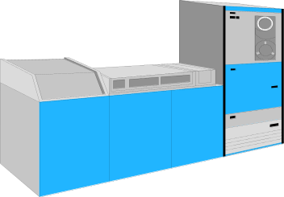
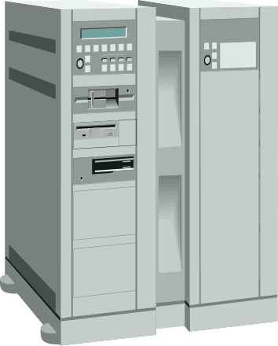
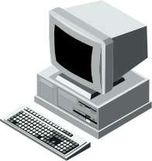
Inmon’s View
Operational Systems
Staging Area
Data Warehouse
Data Marts
LAN
Data Warehouse Server
Processes
Extract
Scrubbing
Transformation
Load Jobs
Aggregation Jobs
Replication
Monitoring
Management
Meta Data Repository
Meta Data Population
Meta Data Maintenance
Detail Data
in ER format
Summarized Data
in Star formats
Data Warehouse (ER) Feeding Multiple Data Marts (Star Schema)

Slide 8
Inmon Approach
Three levels of data modeling
  ERD (Entity Relationship Diagram)
    Refines entities, attributes and relationships
  Mid-Level model (*DIS*)
  Data Item Sets
  Data sets by department
  Four constructs:
    Primary data groupings
    Secondary data groupings
    Connectors
    “Type of” data
  Physical data model
    Optimize for performance (de-normalize)

Slide 9
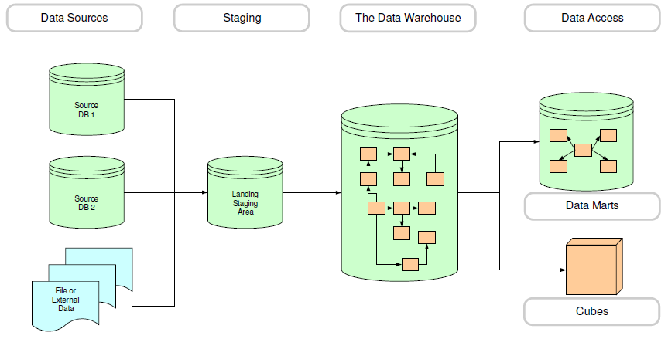
The Inmon Warehouse

Slide 10
Ralph Kimball: Bottom-Up
Recommends, start with small mission critical Data Marts that serve analytic needs of departments….
Then integrate these data marts for data consistency through a so called information bus
Uses star schemas or snowflakes to organize the data in dimensional Modeling data warehouse
Kimball gives his opinion of Independent data marts
More Simpler, Cost effective & Quicker to Deliver
DWH Bus Architecture consist of both the Atomic and Aggregated Data Marts data, stored in a star schema

Slide 11
Kimball’s View
Each Star is
a Data Mart and has both summary and detail data
Operational Systems
Presentation Server
Staging Area
LAN
Data Warehouse
Server
Processes
DW is sum
total of all
Data Marts
Extract
Scrubbing
Transformation
Load Jobs
Aggregation Jobs
Replication
Monitoring
Management
Meta Data Repository
Meta Data Population
Meta Data Maintenance
DW Bus using
Conformed Dimensions
Multiple Data Marts With Conformed Dimensions

Slide 12
The Kimball Approach
The Dimensional Data Model
  Starts with tables
    Facts
    Dimensions
  Facts contain metrics
  Dimensions contain attributes
    May contain repeating groups
  Does not adhere to normalization theory
  User accessible

Slide 13
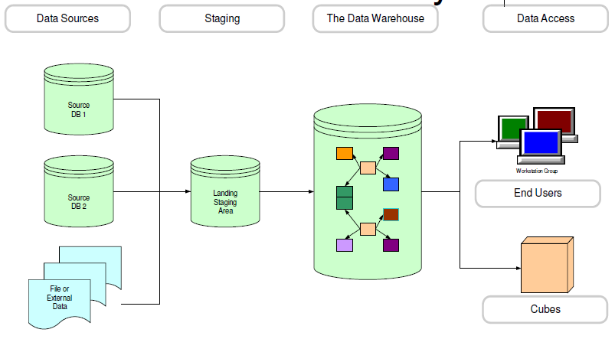
The Kimball Data Lifecycle

Slide 14
The Kimball Data Bus
Data is moved to staging area
  Data is scrubbed and made consistent
From Staging Data Marts are created
Data Marts are based on a single process
Sum of the data marts can constitute an Enterprise Data Warehouse
Conformed dimensions are the key to success

Slide 15
The Kimball Design
Select business process
Declare the grain
Choose dimensions
Identify facts (metrics)

Slide 16
Kimball’s Philosophy
Make data easily accessible
Present the organization’s information consistently maintained
Be adaptive and resilient to change
Protect information
Service as the foundation for improved
decision making.

Slide 17
Getting Started with Choices
Kimball
  Will start with data marts
  Focused on quick delivery to users
Inmon
  Will focus on the enterprise
  Organizational focus

Slide 18
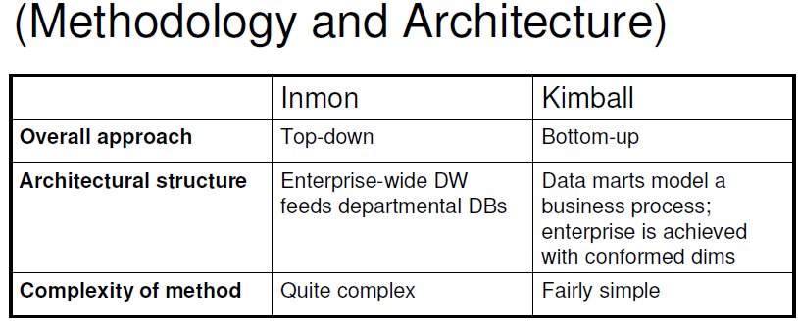
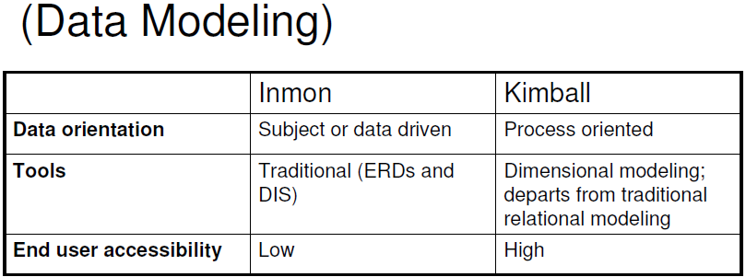
The Comparison

Slide 19
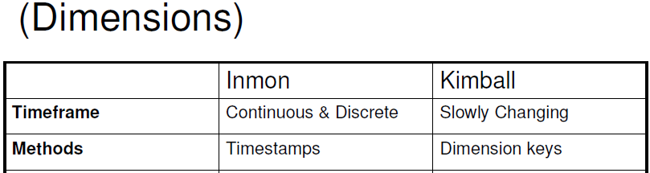
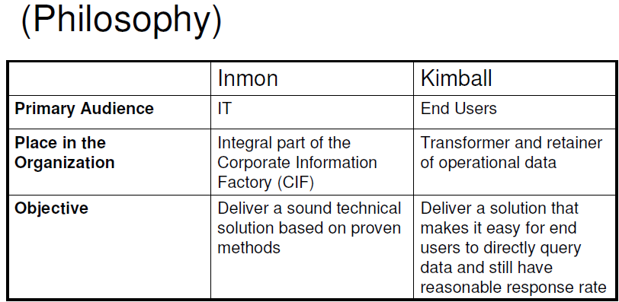
The Comparison

Slide 20
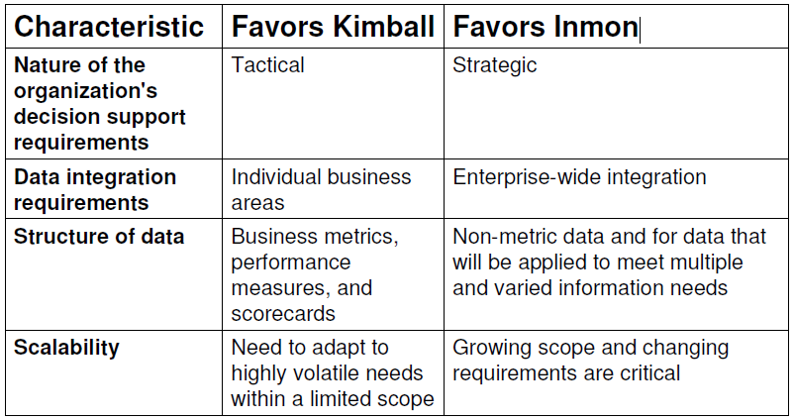
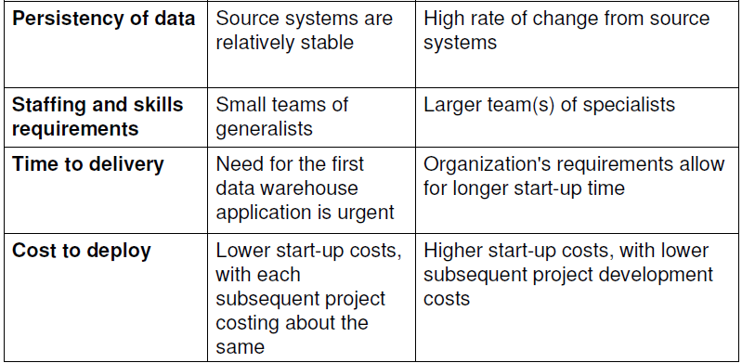
How to Choose?

Slide 21
Dimension Management
Inmon Continuous & Discrete
Define data management via dates in your data
  Continuous time
    When is a record active
    Start and end dates
  Discrete time
    A point in time
    Snapshot

Slide 22
Dimension Management
Kimball Slowly Changing
Define data management via versioning
  Type I
    Change record as required
    No History
  Type II
    Manage all changes
    History is recorded
  Type III
    Some history is parallel
    Limit to defined history

Slide 23
Kimball vs. Inmon
Inmon:
  Subject-Oriented
  Integrated
  Non-Volatile
  Time-Variant
  Top-Down
  Integration Achieved via an Assumed Enterprise Data Model
  Characterizes Data marts as Aggregates
Kimball
  Business-Process-Oriented
  Bottom-Up and Evolutionary
  Stresses Dimensional Model, Not E-R
  Integration Achieved via Conformed Dimensions
  Star Schemas Enforce Query Semantics

Slide 24
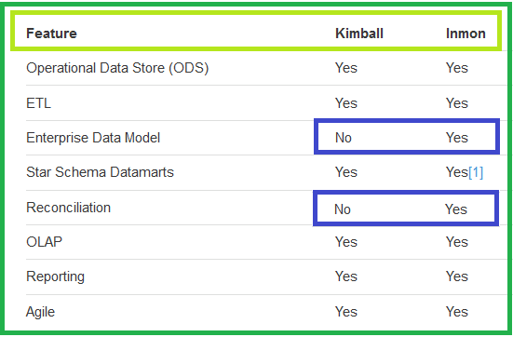
Kimball Vs Inmon

Slide 25
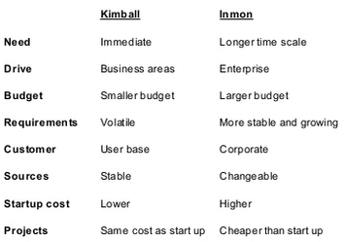
Kimball vs. Inmon approach

Slide 26
Complementary Approach
Common elements: in Both Approaches
There is no right or wrong approach and it totally depends on kind of requirement, project nature to decide the approach.
Both Kimball and Inmon’s architectures share a same common feature that each has a single integrated repository of atomic data.
Both architectures have an enterprise focus that supports information analysis across the organization.
Both enables to address the business requirements not only within a subject area but also across subject areas.

Slide 27
Complementary Approach
Common elements: in Both Approaches
When it comes to data modelling, depends on specific requirements, sometimes makes sense to take a hybrid approach.
Both these models have their own strengths and weakness.
All enterprises require a means to store, analyze and interpret the data they generate and accumulate in order to implement critical decisions that range from “continuing to exist” to maximizing prosperity.

Slide 28
Basics: What is a Data Warehouse:
The single organizational repository of enterprise wide data across many or all lines of business and subject areas.
  Contains massive and integrated data
  Represents the complete organizational view of information needed to run and understand the business

Slide 29
The Data Warehouse Is:
Bill Inmon, an early and influential practitioner, has formally defined a data warehouse in the following terms;
Subject-oriented
  The data in the database is organized so that all the data elements relating to the same real-world event or object are linked together;
Time-variant
  The changes to data in the database are tracked and recorded so that reports can be produced showing changes over time;
Non-volatile
  Data in the database is never over-written or deleted once committed, the data is static, read-only, but retained for future use
Integrated
  The database contains data from most or all of an organization's operational applications, and that this data is made consistent
Ralph Kimball, a leading proponent of the dimensional approach to building data warehouses, provides a succinct definition for a data warehouse:
“A copy of transaction data specifically structured for query and analysis.“

Slide 30
Data Warehouse—Subject-Oriented
Organized around major subjects, such as customer, product, sales.
Focusing on the modeling and analysis of data for decision makers, not on daily operations or transaction processing.
Provide a simple and concise view around particular subject issues by excluding data that are not useful in the decision support process.

Slide 31
Data Warehouse - Integrated
Constructed by integrating multiple, heterogeneous data sources
  relational databases, flat files, on-line transaction records
Data cleaning and data integration techniques are applied.
  Ensure consistency in naming conventions, encoding structures, attribute measures, etc. among different data sources
    E.g., Hotel price: currency, tax, breakfast covered, etc.
  When data is moved to the warehouse, it is converted.

Slide 32
Data Warehouse -Time Variant
The time horizon for the data warehouse is significantly longer than that of operational systems.
  Operational database: current value data.
  Data warehouse data: provide information from a historical perspective (e.g., past 5-10 years)
Every key structure in the data warehouse
  Contains an element of time, explicitly or implicitly
  But the key of operational data may or may not contain “time element”.

Slide 33
Data Warehouse - Non Updatable
A physically separate store of data transformed from the operational environment.
Operational update of data does not occur in the data warehouse environment.
  Does not require transaction processing, recovery, and concurrency control mechanisms.
  Requires only two operations in data accessing:
    initial loading of data and access of data.

Slide 34
Data Warehouse Architectures
1.Generic Two-Level Architecture
2.Independent Data Mart
3.Dependent Data Mart and Operational Data Store
4.Logical Data Mart and Active Warehouse
5.Three-Layer architecture
All involve some form of extract, transform and load (ETL)

Slide 35
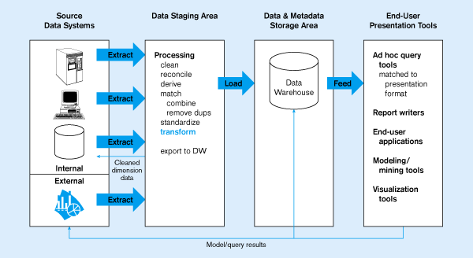
Figure 11-2: Generic two-level architecture
E
One, company-wide warehouse
T
L
Periodic extraction ➔ data is not completely current in warehouse

Slide 36
Independent Data mart
Independent data mart: a data mart filled with data extracted from the operational environment without referring of a data warehouse.

Slide 37
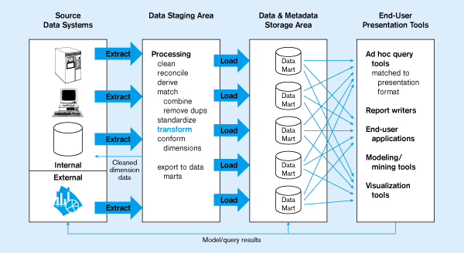
Figure 11-3: Independent Data Mart
Data marts:
Mini-warehouses, limited in scope
L
T
E
Separate ETL for each independent data mart
Data access complexity due to multiple data marts

Slide 38
Dependent data mart -
Operational data store
Dependent data mart: A data mart filled exclusively from the enterprise data warehouse and its reconciled data.
Operational data store (ODS): An integrated, subject-oriented, updatable, current-valued, enterprise-wise, detailed database designed to serve operational users as they do decision support processing.

Slide 39
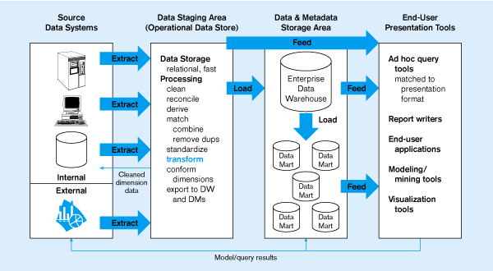
Dependent data mart with operational data store
ODS provides option for obtaining current data
L
T
E
Simpler data access
Single ETL for
enterprise data warehouse
(EDW)
Dependent Data Marts loaded from EDW

Slide 40
Three-layer architecture
Reconciled and derived data
Reconciled data: detailed, current data intended to be the single, authoritative source for all decision support.
Derived data: Data that have been selected, formatted, and aggregated for end-user decision support application.
Metadata: technical and business data that describe the properties or characteristics of other data.

Slide 41
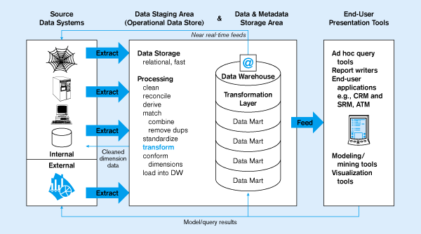
Logical data mart and @ctive data warehouse
ODS and data warehouse are one and the same
L
T
E
Near real-time ETL for
@active Data Warehouse
Data marts are NOT separate databases, but logical views of the data warehouse
➔ Easier to create new data marts

Slide 42
Other data warehouse changes
New descriptive attributes
New business activity attributes
New classes of descriptive attributes
Descriptive attributes become more refined
Descriptive data are related to one another
New source of data

Slide 43
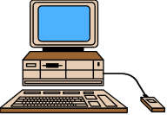
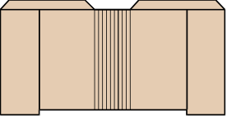




Typical (Graphical) DWH Architecture
Data
Marts
EIS /DSS
Metadata
Select
Extract
Transform
Integrate
Maintain
Query Tools
Data
Warehouse
OLAP/ROLAP
Web Browsers
Operational
Systems/Data
Middleware/
API
Data
Preparation
Data Mining
Multi-tiered Data Warehouse without ODS

Slide 44
Typical (Graphical) DWH Architecture
Data
Marts
Metadata
Metadata
Select
Extract
Transform
Integrate
Maintain
Select
Extract
Transform
Load
ODS
Data
Warehouse
Operational
Systems/Data
Data
Preparation
Data
Preparation
Multi-tiered Data Warehouse with ODS

Slide 45
Warehouse Architecture - 1
EIS /DSS
Metadata
Select
Extract
Transform
Integrate
Maintain
Query Tools
Data
Warehouse
OLAP/ROLAP
Operational
Systems/Data
Web Browsers
Middleware/
API
Data
Preparation
Data Mining
Enterprise Data Warehouse

Slide 46
Warehouse Architecture - 2
Metadata
EIS /DSS
Data Mart
Select
Extract
Transform
Integrate
Maintain
Metadata
Query Tools
Data Mart
OLAP/ROLAP
Metadata
Operational
Systems/Data
Web Browsers
Data Mart
Middleware/
API
Data
Preparation
Data Mining
Single Department Data Mart

Slide 47
Warehouse Architecture - 3
Data
Marts
EIS /DSS
Metadata
Select
Extract
Transform
Integrate
Maintain
Query Tools
Data
Warehouse
OLAP/ROLAP
Web Browsers
Operational
Systems/Data
Operational Data Store
Middleware/
API
Data
Preparation
Data Mining
Multi-tiered Data Warehouse

Slide 48
What is OLTP System
OLTP (online transaction processing) is a class of software programs capable of supporting transaction-oriented applications on the Internet.
The main characteristics of an OLTP environment are:
  Short response time. ...
  Small transactions. ...
  Data maintenance operations. ...
  Large user populations. ...
  High concurrency. ...
  High availability. ...
  Lifecycle-related data usage.

Slide 49
OLTP to Data warehouse (OLAP)
OLTP and data warehousing requires, two very differently configured systems
Isolation of Production System from Business Intelligence System is a mandatory process
Significant and highly variable resources, are in demands of the data warehouse
Cost of disk space no longer a concern
Production/Operational systems not designed for Query based support.

Slide 50



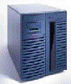
OLTP Systems Vs Data Warehouse
Remember
Between OLTP and Data Warehouse systems
users are different
data content is different,
data structures are different
hardware is different
Understanding The Differences Is The Key

Slide 51
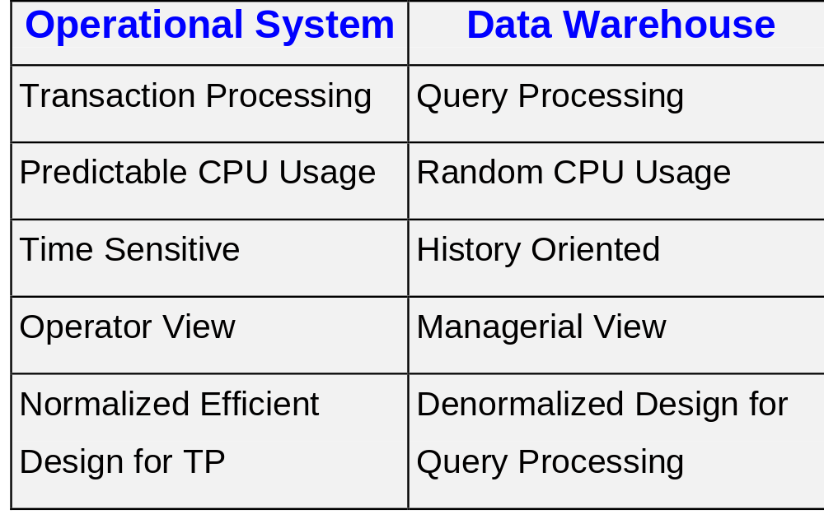
OLTP Vs Warehouse

Slide 52
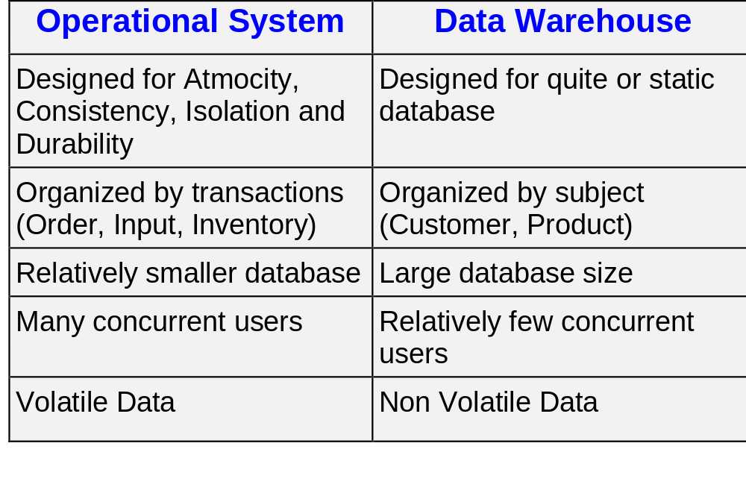
OLTP Vs Warehouse

Slide 53
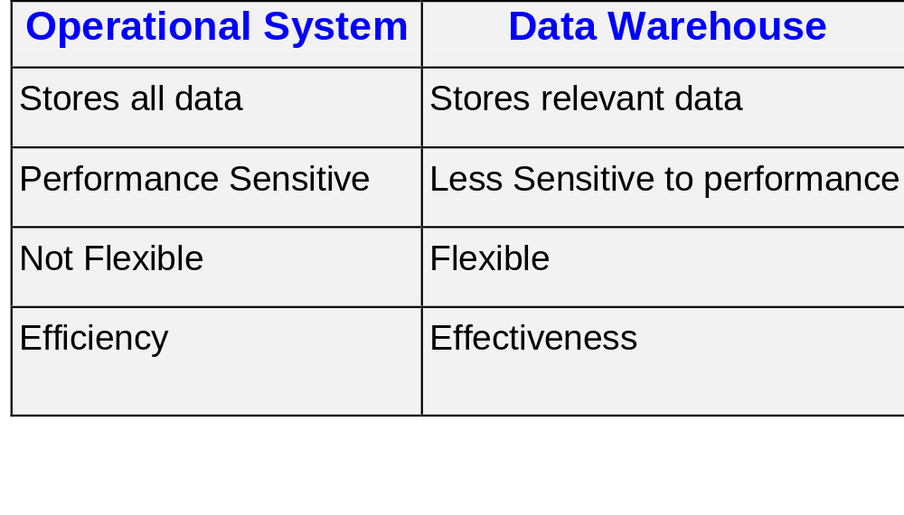
OLTP Vs Warehouse

Slide 54


Capacity Planning
Processing Power
Time of day
Processing Load Peaks During the Beginning and End of Day

Slide 55
What is a Data Mart?
The specific, subject oriented, or departmental view of information from the organization.
Generally these are built-in to satisfy user requirements for information
Multiple data marts for one organization
A data mart is built using dimensional modeling
More focused
Generally smaller, selected facts and dimensions
Integrated

Slide 56
Characteristics of Data Marts
Enterprise wide data warehousing projects have a very large cycle time
Getting consensus between multiple parties may also be difficult
Departments may not be satisfied with priority accorded to them
Sometimes individual departmental needs may be strong enough to warrant a local implementation
Application/database distribution is also an important factor

Slide 57
Characteristics of Data Marts
Subject or Application Oriented Business View of Data Marts are:
  Finance, Manufacturing, Sales etc.
  Smaller amount of data used for Analytic Processing
  Address of a single business process
A Logical Subset of The Complete Data Warehouse

Slide 58
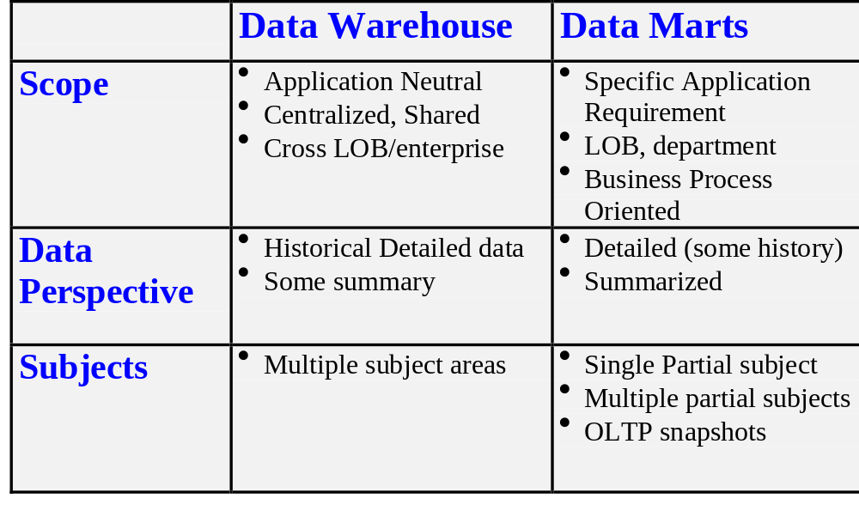
Data Warehouse and Data Mart

Slide 59
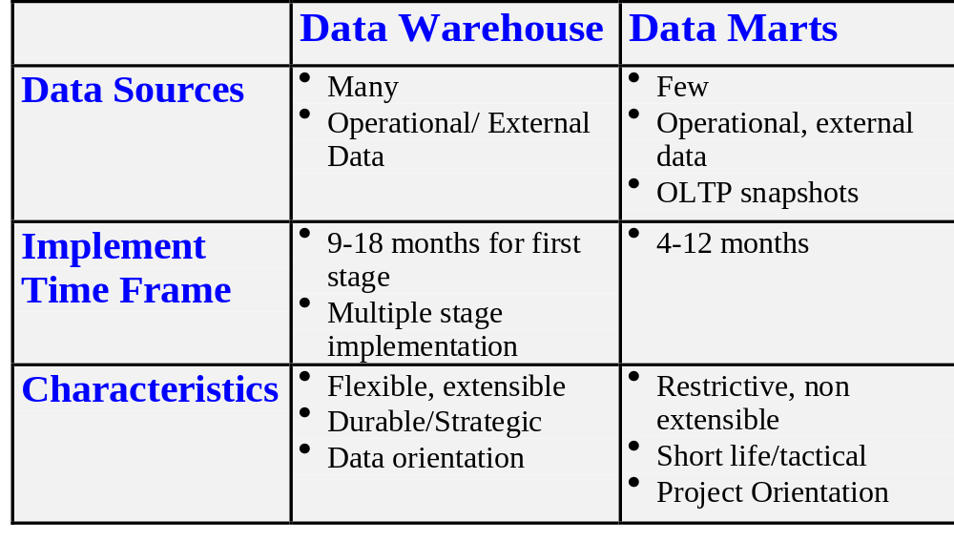
Data Warehouse and Data Mart

Slide 60
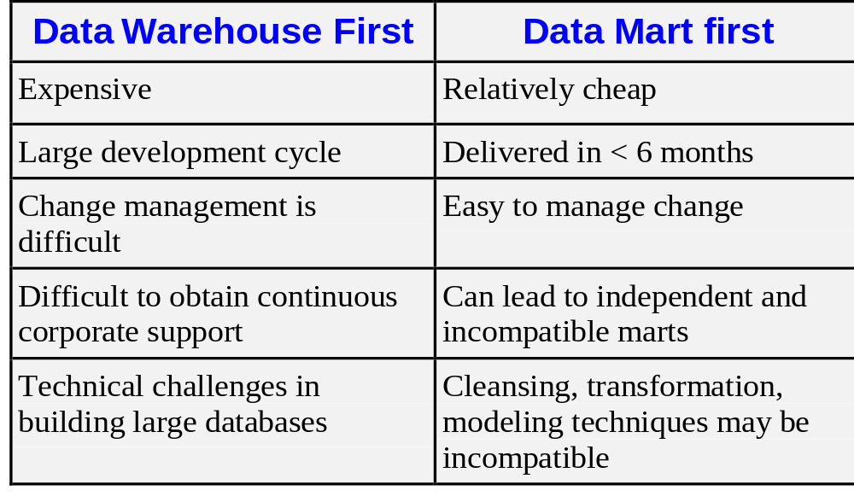
Warehouse or Mart First ?

Slide 61
Different kinds of Information Needs
Current
Recent
Historical
Is this medicine available in stock
What are the tests this patient has completed so far
Has the incidence of Tuberculosis increased in last 5 years in Southern region
OLTP
ODS
Data Warehouse

Slide 62
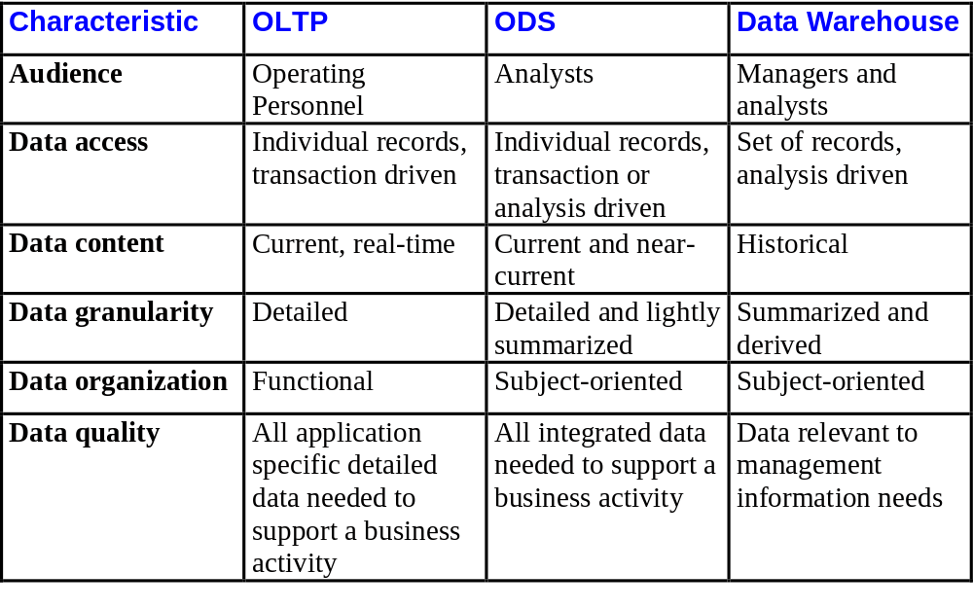
OLTP Vs ODS Vs DWH

Slide 63
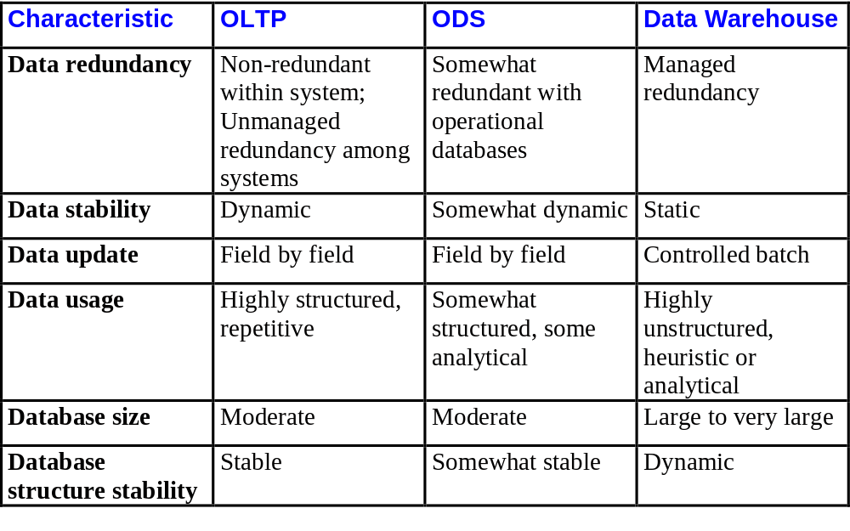
OLTP Vs ODS Vs DWH

Slide 64
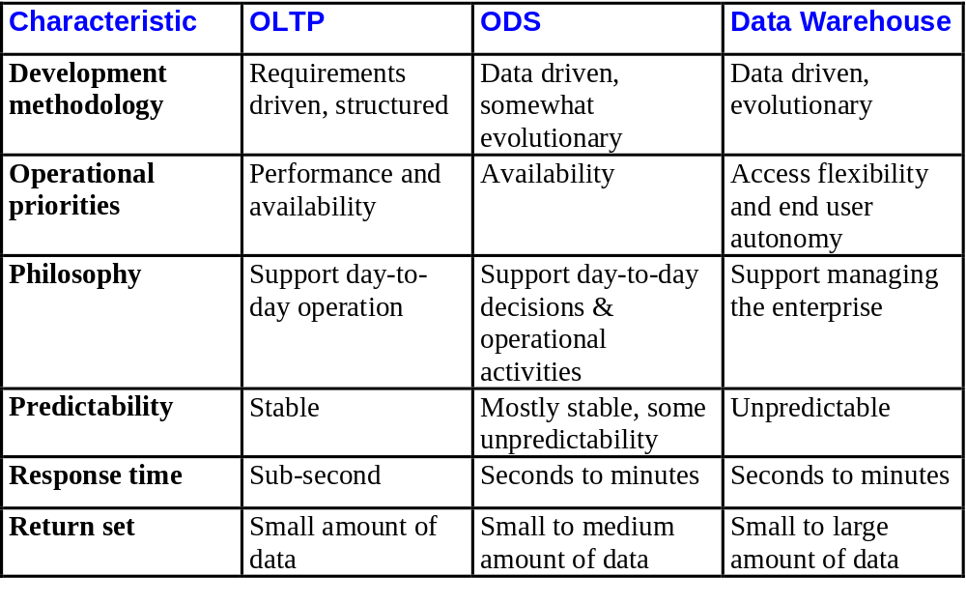
OLTP Vs ODS Vs DWH

Slide 65
OLTP Systems Vs Data Warehouse Application
Between OLTP and DWH systems
users are different
data content is different,
data structures are different
hardware is different
Understanding The Differences Is The Key

Slide 66



Examples Of Some Applications
Target Marketing
Market Segmentation
Budgeting
Credit Rating Agencies
Financial Reporting and Consolidation
Retailers
Manufacturers
Market Basket Analysis - POS Analysis
Fraud Management
Profitability Management
Event tracking
Customers

Slide 67


Thank you

